Slide 1
Other Open-Source and PV Modeling PAckages
Silvana Ovaitt
Mark Mikofski
PVSC 2050
Notes:
30 minutes (please stay on limit) followed by discussion
Please choose your own title, but the goal is to help the audience understand how you would go about developing and implementing a collaborative vision for PV systems performance and reliability work at NREL, as well as address a growing need for performance analysis of power electronics, storage, and other complementary technologies that are critical to grid integration and sector coupling for PV. While it is fine to briefly highlight a few of your contributions and/or interests in these areas, this is not designed to be a standard one hour technical seminar on a specific topic. Instead, please address what you see as important topics and emerging directions in reliability and systems performance for PV and related technologies, how NREL can and should contribute high impact work in these areas for the nation and the world, and both the challenges and opportunities that lie ahead.

Slide 2
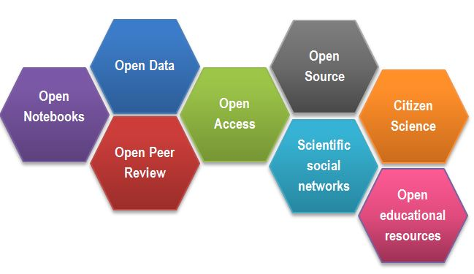
Open-Source Science
https://www.fosteropenscience.eu/content/what-open-science-introduction

Slide 3
FIELDS:
Electrical
Optical
Materials
Mechanicals
More+
Basic Science
Module
PV System
Efficiency Increases
LCOE Reductions
Installation Projections
Topics
Economics
Sustainability
More+
PUSHING THE ENVELOPE
Solar +
ML
IoT
Grid Integration
Electric Cars
STORAGE (BATTERIES)
More+

Slide 4
How can your code have more impact?
Code
Experiments notebook (Jupyter)
Sharing Github / Gitlab
Licensing*
Documentation: READ.me, Sphinx, Read the Docs, Tutorials
Versioning, Easy Installation (“pip”), Requirements, Releases
Pytest
Community and user support

Slide 5
Example Gallery

Slide 6
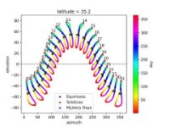
SUN POSITION
PVLIB Example Gallery
https://pvlib-python.readthedocs.io/en/stable/gallery/index.html

Slide 7
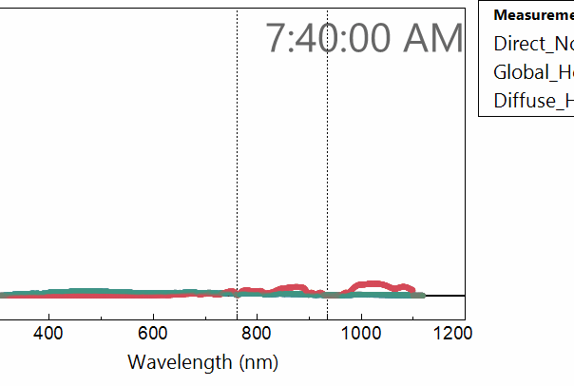
Spectral Data
Spectral Data Modeling

Slide 8
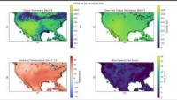
Satellite Weather Data
Satellite Weather Data
https://www.youtube.com/watch?v=6MQNUMVpC2k

Slide 9
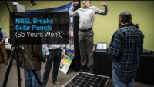
Reliability - FMA
Research + Modeling

Slide 10
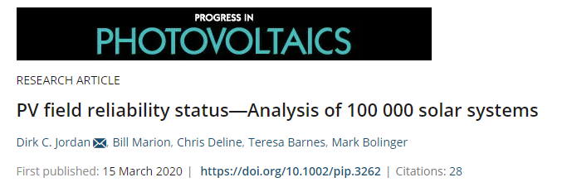
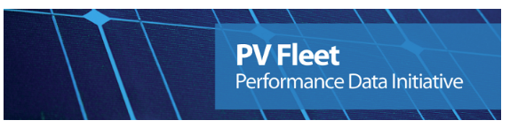
https://www.nrel.gov/pv/fleet-performance-data-initiative.html

Slide 11
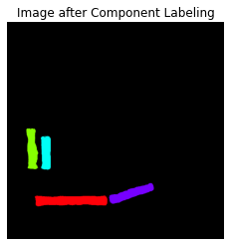
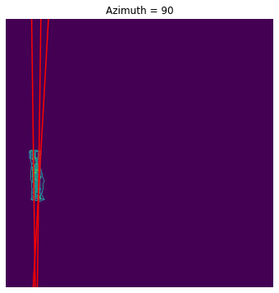
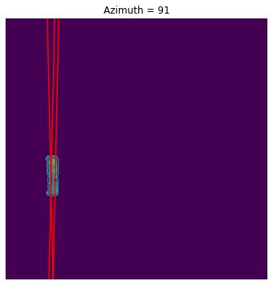
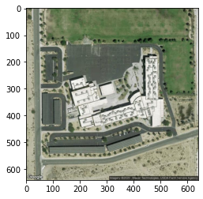
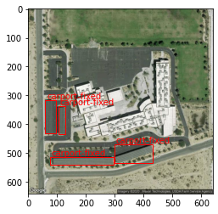
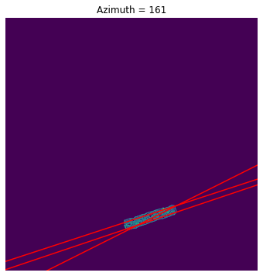
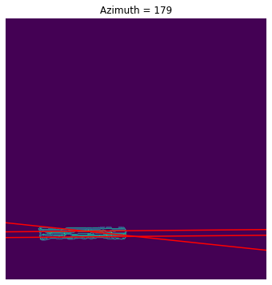
Machine Learning
Mounting Configuration Classification
Azimuth Estimation
Detects fixed-tilt carport installation as mounting configuration using object detection algorithm (CNN)
Solar array clustering via Connected Components Algorithm
Pulls down satellite image of location via Google Maps API
Azimuths: 90, 90, 160, 180.
Detected via Canny Object Detection + Hough Line Transform

Slide 12
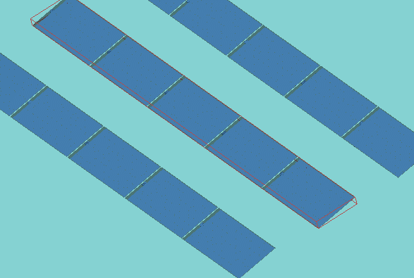
Modeling

Slide 13
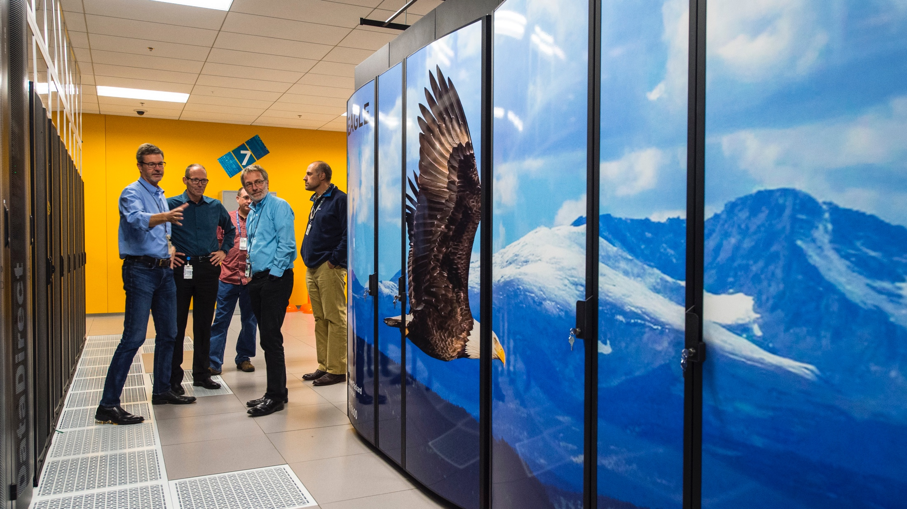
Modeling Software / Models

Slide 14

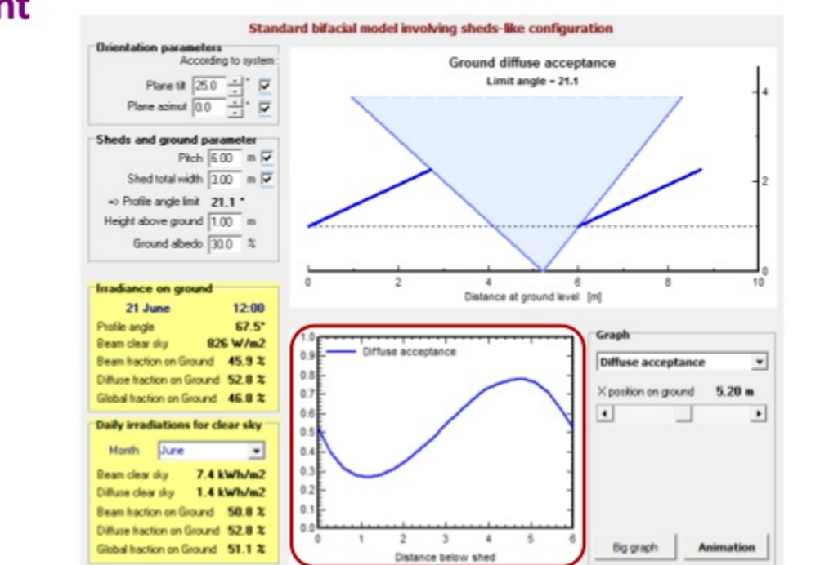
DUE DILIGENCE SOFTWARE

Slide 15


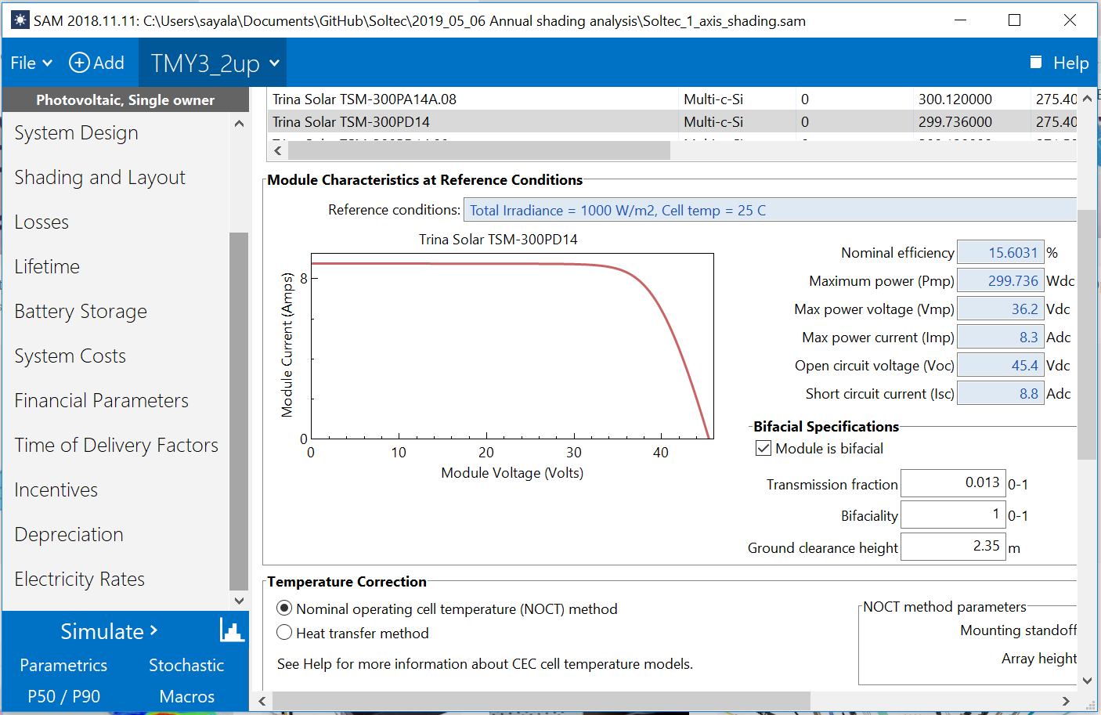
DUE DILIGENCE SOFTWARE
https://sam.nrel.gov/
https://github.com/NREL/pysam
ALSO ACCESSIBLE THROUGH PYSAM

Slide 16
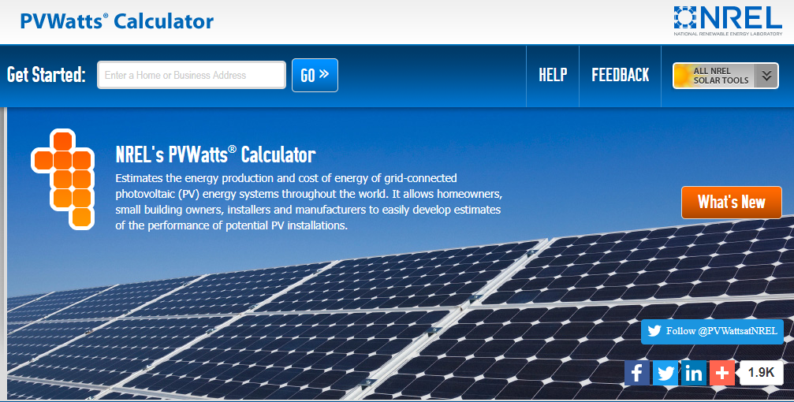
Rooftop Energy production calculation
*Also accessible through pvlib functions

Slide 17
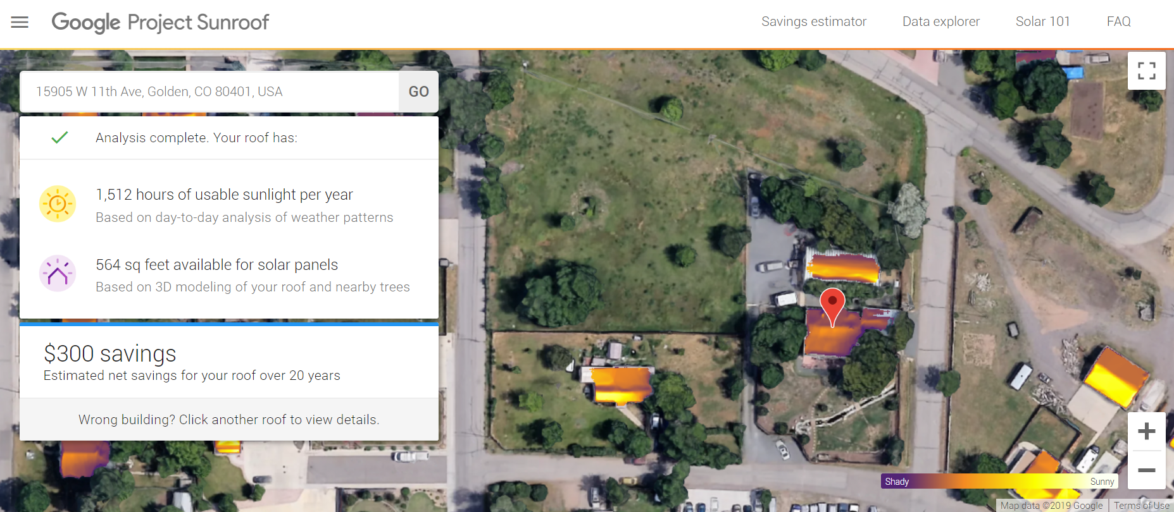
Rooftop Energy production calculation
*Also accessible through pvlib functions

Slide 18
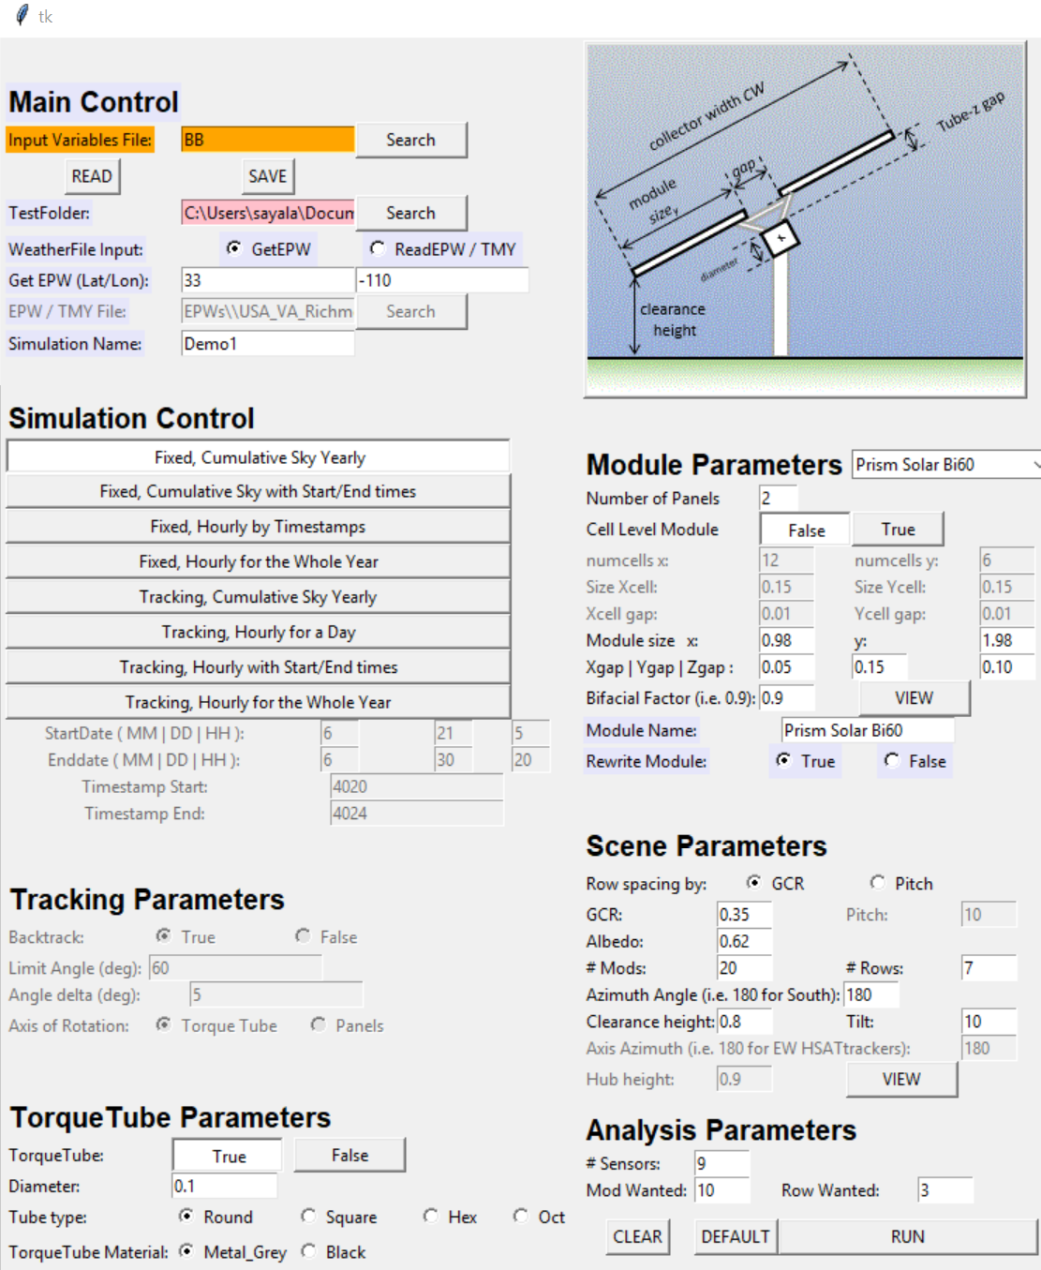
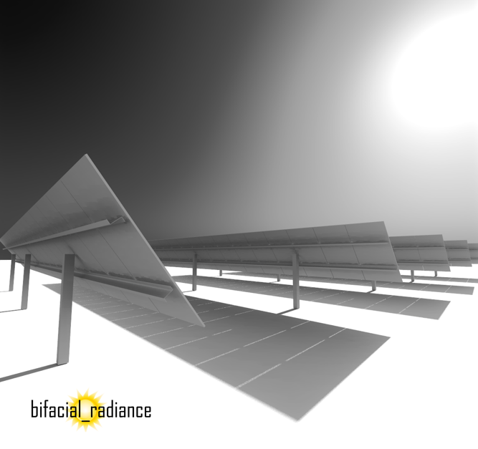
Bifacial and AgriPV Modeling
https://github.com/NREL/bifacial_radiance
Image courtesy of J. Alderman
Ayala Pelaez, Silvana, Deline, Chris (2020). bifacial_radiance: a python package for modeling bifacial solar photovoltaic systems. Journal of Open Source Software, 5(50), 1865, https://doi.org/10.21105/joss.01865

Slide 19
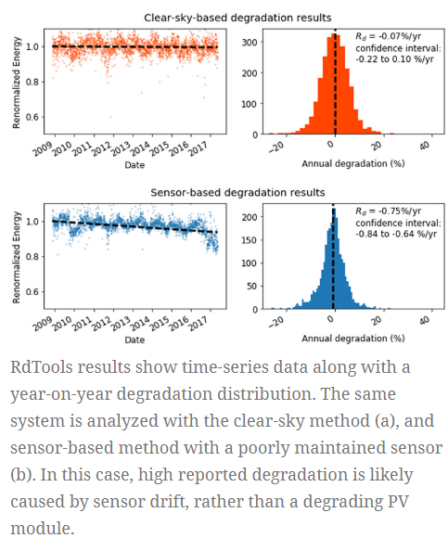
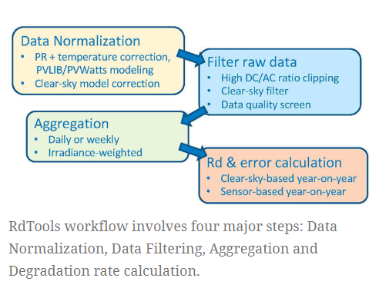
Degradation Modeling
https://github.com/NREL/rdtools
RDTools

Slide 20
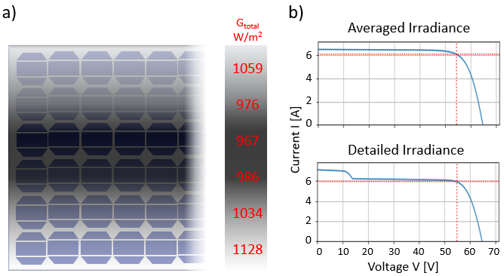

PVMismatch
Cell-level electrical mismatch
https://github.com/SunPower/PVMismatch

Slide 21

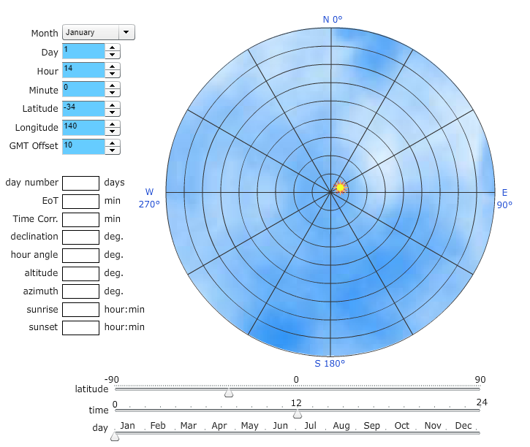
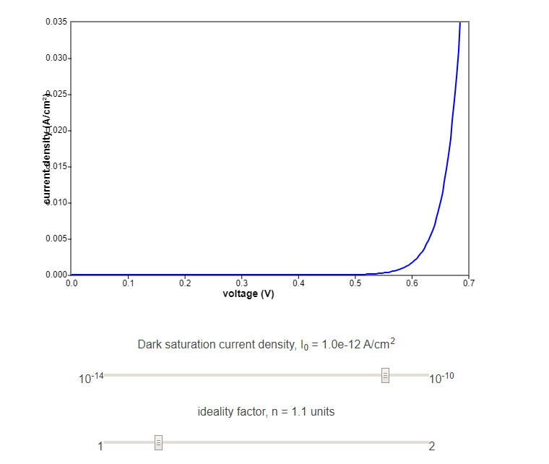
Education

Slide 22
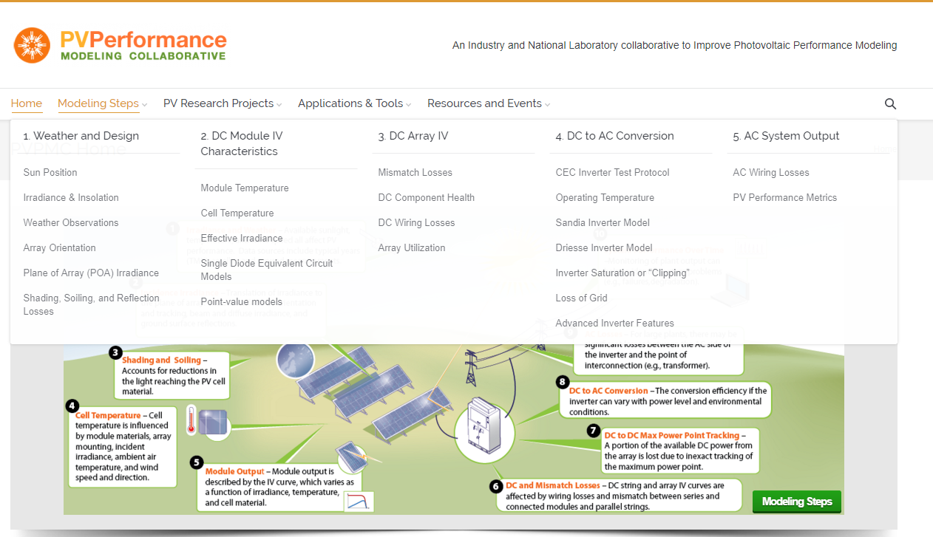
Education

Slide 23
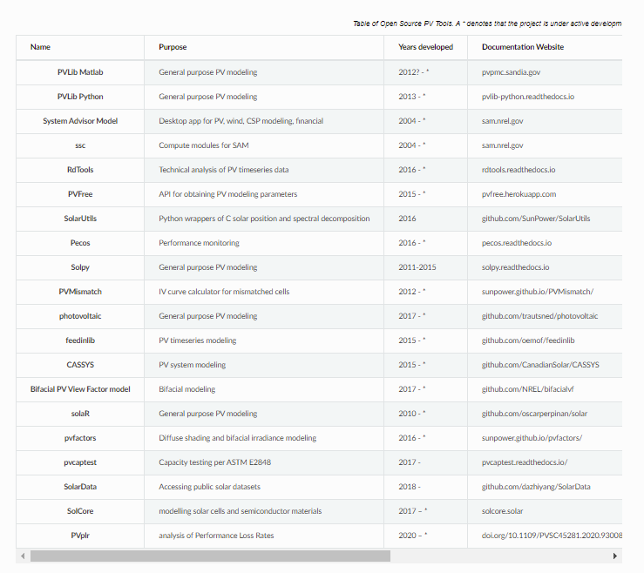

Collection of Open-Source Solar PV Modeling tools
https://github.com/openpvtools/openpvtools
More available on:
https://github.com/openpvtools/openpvtools

Slide 24
Non-exhaustive list of other solar githubs
https://github.com/pvlib/pvanalytics
https://github.com/NREL/bifacialVF
https://github.com/NREL/PySMARTS
https://github.com/NREL/PV_ICE
https://github.com/DuraMAT/pvpro
https://github.com/DuraMAT/pv-terms
https://github.com/qpv-research-group/solcore5
https://github.com/sandialabs/pvOps

Slide 25
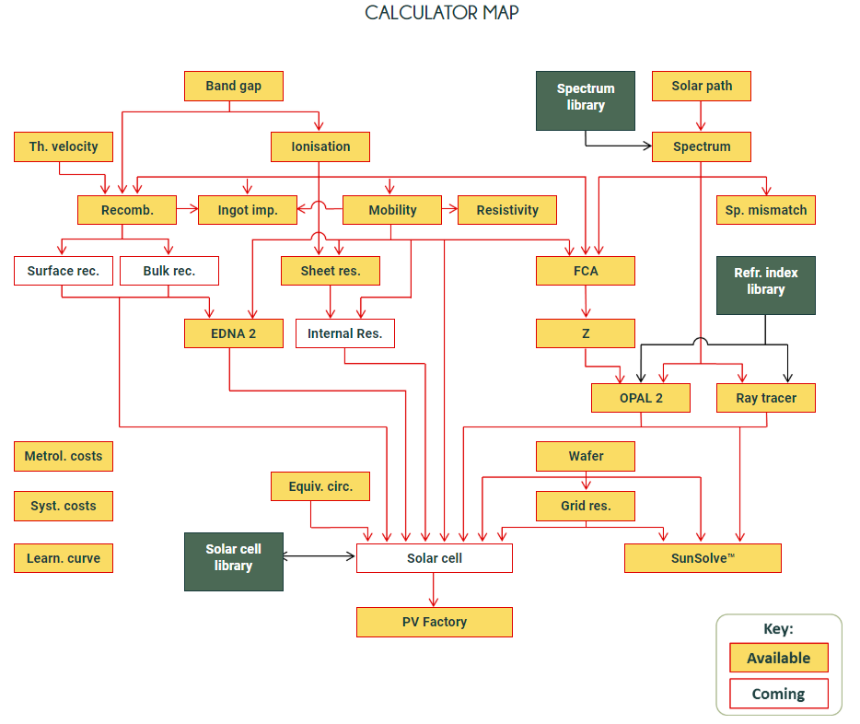

Commercial Tools
Some features/calculators
On this page are free for use

Slide 26
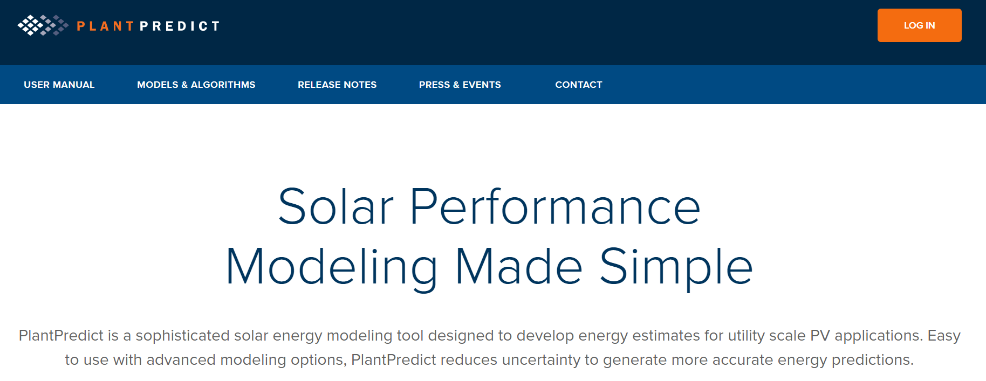
Commercial Tools
PlantPredict – First Solar

Slide 27
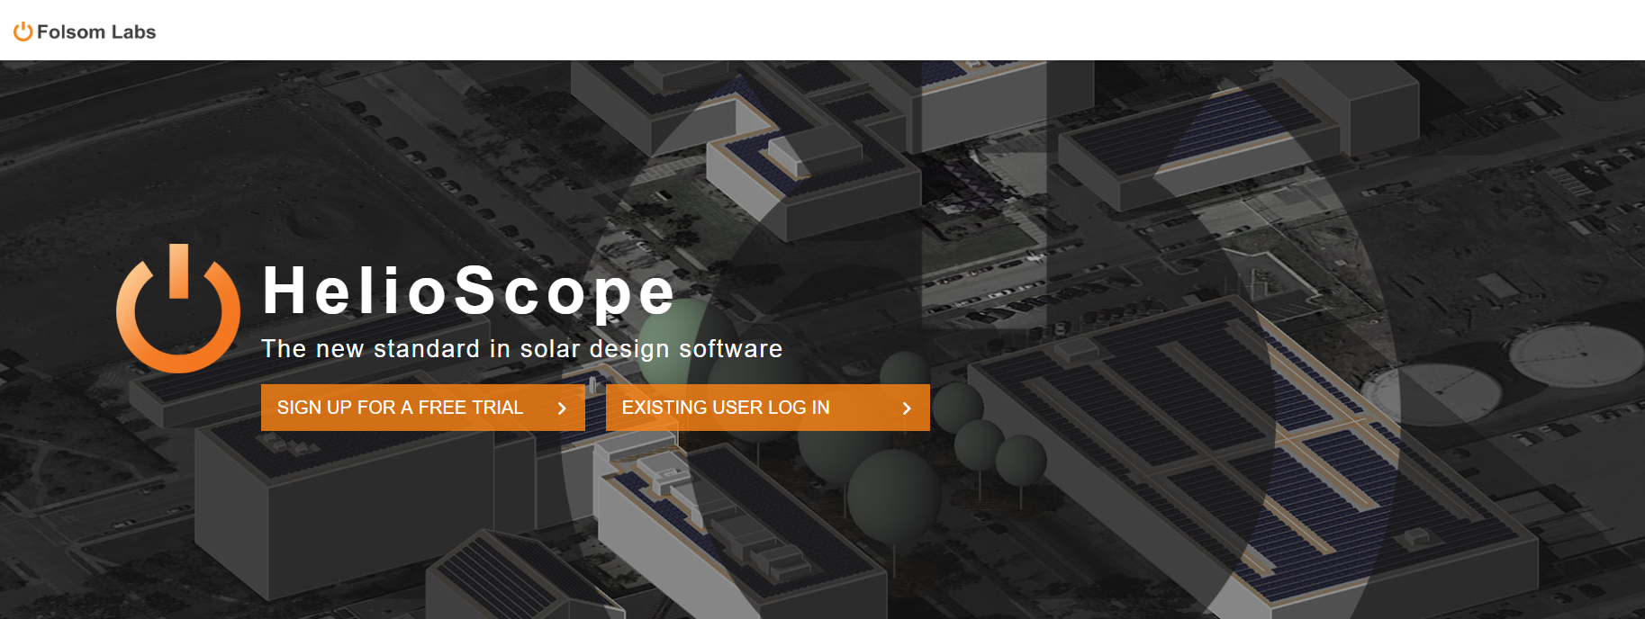
Commercial Tools
Helioscope

Slide 28
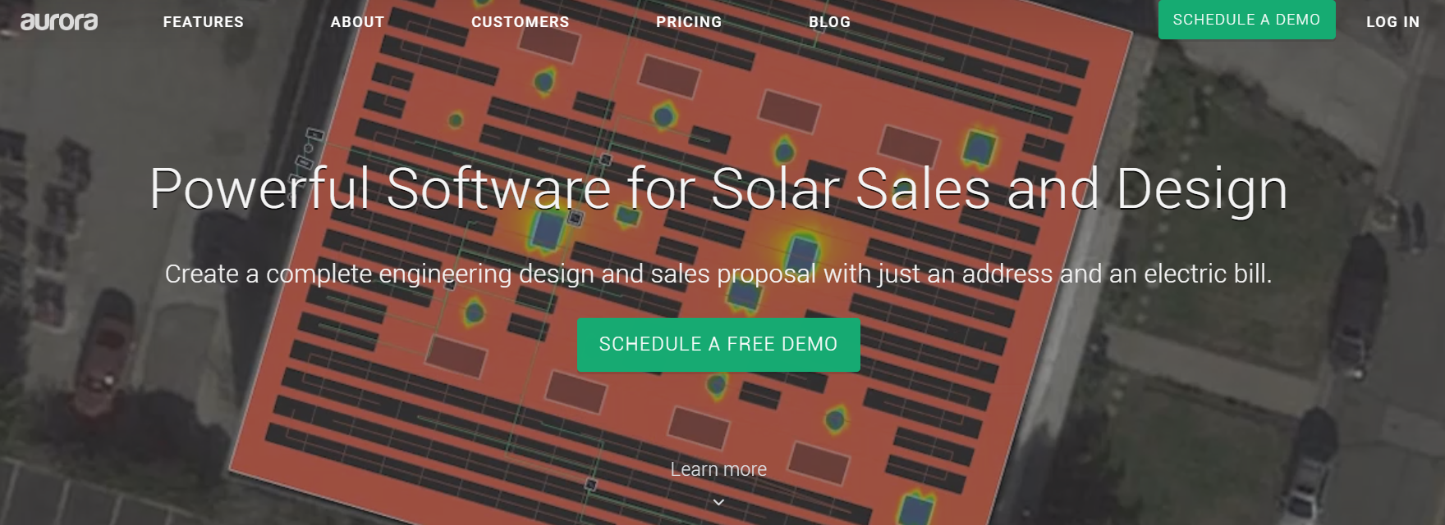
Commercial Tools
Aurora Solar

Slide 29
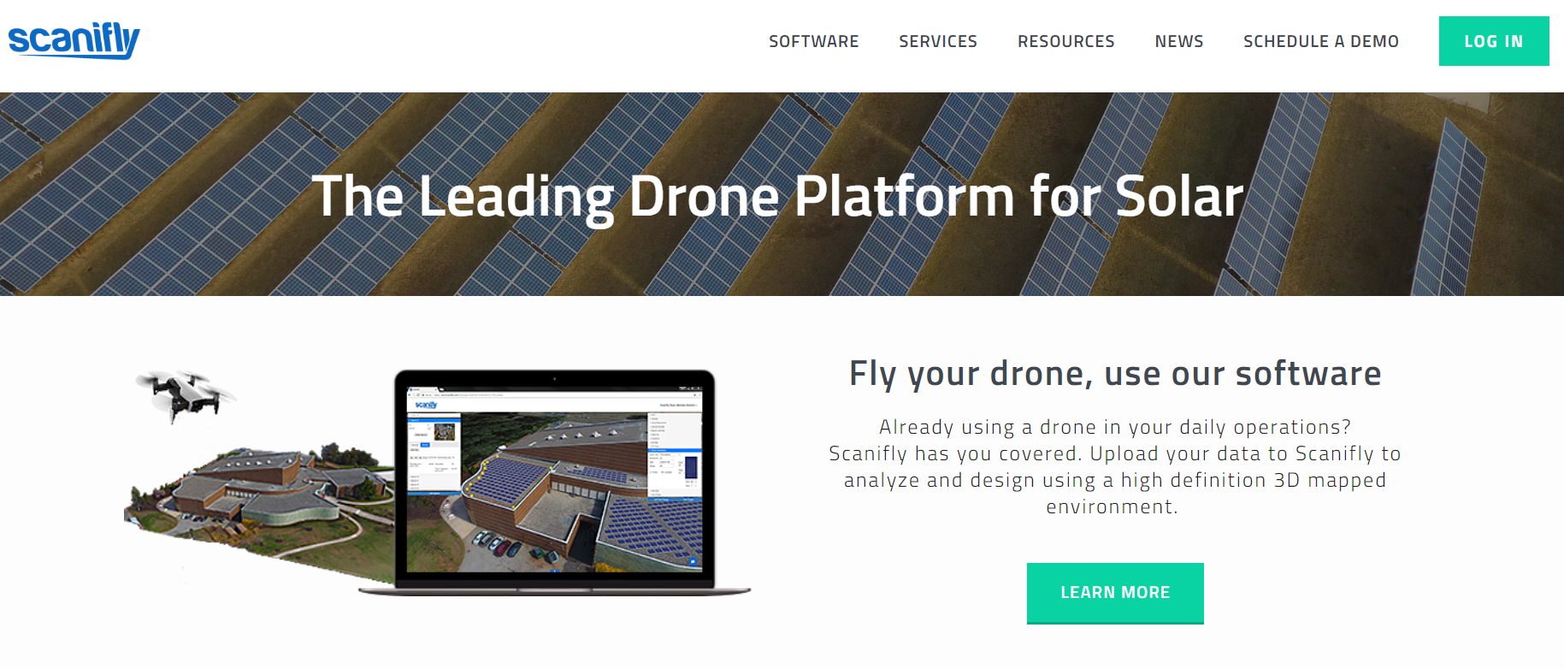
Commercial Tools
Scanifly

